Slide 1
What Makes Something Evidence?
Evidence is a key item in the process of disambiguation.
Remember the board game Guess Who? You have a group of 24 people. You each draw a card with 1 of the 24 people on it, and you take turns asking a single question until you correctly guess which person is on their card.
That process of questioning is disambiguation. You are trying to ask questions that narrow down your data to a single subject in as few steps as possible.

Slide 2
Characteristics of Digital Evidence
It is latent, same as fingerprints and DNA
It can transcend national borders with ease and speed
It is highly fragile and easily altered, damaged, or destroyed
It is often time sensitive

Slide 3
Characteristics of Digital Evidence
Digital evidence contains important information, for example:
when the file was created, accessed and modified, often referred to as the Modification, Access and Creation or MAC times associated with the file;
where the file is stored, by the file path;
what the function of the file is by examining the extension and header data in the file;
the owner and creator of a file;
size of the file, which can be an indication that it is not consistent with a known file;
hash signature by which the data can uniquely be identified.

Slide 4
Characteristics of Evidence
Class Characteristics
Measurable features of an item that indicate a restricted group source based on design factors determined prior to manufacture – LIKE or CONSISTENT with a source, but not uniquely identifiable.
The shape of the head of a screwdriver.
A bloodstain
A file type (.docx)

Slide 5
Characteristics of Evidence
Subclass Characteristics
Features of an object produced incidental to manufacture, which refer to a smaller group source and may change over time.
The serial number stamped on a gun.
Blood type
A hash value

Slide 6
Characteristics of Evidence
Individual Characteristics
Features produced by random imperfections or irregularities in the manufacture of the object or by use, abuse or corrosion. May be uniquely identifiable to a source.
Striation marks on a bullet.
DNA profile from a bloodstain.
Typos in a Word document

Slide 7
Characteristics of Evidence
Digital evidence can have a lot of characteristics. A computer logs so much metadata with each piece of data that each evidence item could have pages of characteristics associated with it.
That’s why it’s always critical to identify the relevant characteristics of digital evidence.
The hash values associated with data are always relevant. They speak to the integrity of the evidence.
File system metadata is almost always important. File creation, modified, and NTFS permissions all speak to relevancy.

Slide 8
Evidence Identification
Identifying a potential source of evidence can be tricky. Lots of items have the ability to hold evidence but are not relevant to the case. When identifying sources, you should follow these five guidelines:
Observation: What is the device, specifically?
Hypothesis: How is it relevant to the case?
Prediction: What do you expect to see, evidence-wise?
Experimentation: What tests could be run to preserve, identify, and authenticate evidence on the item?
Conclusions: Assuming you are correct, and the item contains evidence, what conclusions might be drawn from it?

Slide 9
Evidence Identification
With digital evidence, we have layers.
Laptop has characteristics.
The hard drive inside it has characteristics
The data on the hard drive has characteristics.
So which do we pay attention to?
Whichever you are examining at the time.
If you are examining the laptop, and your report includes only an examination of the contents of the hard drive, then your search was not thorough.
If you are examining the hard drive, and your report excludes the characteristics of the physical device your report is not complete.
If you are examining data and your report does not include hash values it is not valid.

Slide 10
Quick Note
Carl Sagan once said, “The absence of evidence isn’t evidence of absence.”
However, evidence of absence is evidence of absence, especially when it comes to digital evidence. Certain things should be there. If they aren’t that is still evidence of something.

Slide 11
Evidence Dynamics
Any influence that adds, changes, relocates, obscures, contaminates, or obliterates physical evidence, regardless of intent. Evidence dynamics are at work in a scene even before an event happens that requires reconstruction, waiting to confuse, mislead, and confound.
Examples:
Weather.
An application was installed, overwriting unallocated space.
Help desk agents deleted what they believed to be malware.
First responder didn’t follow procedure.
Animals / insects in the crime scene.

Slide 12
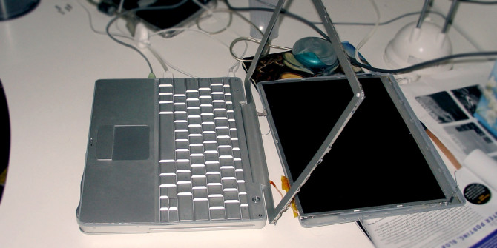

Slide 13
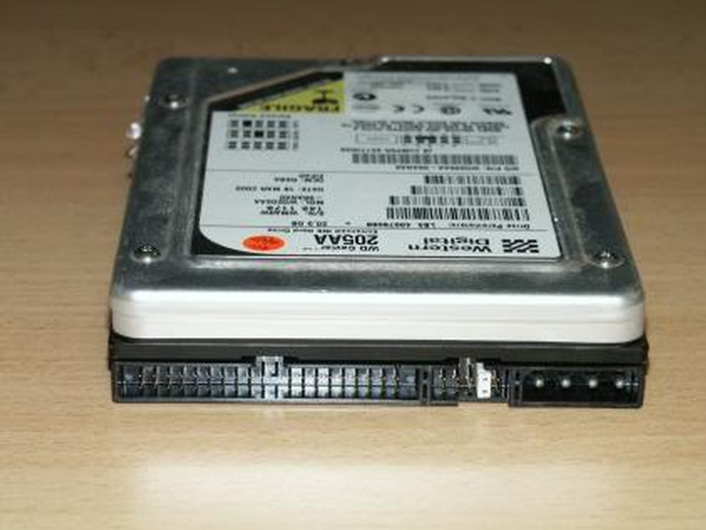

Slide 14
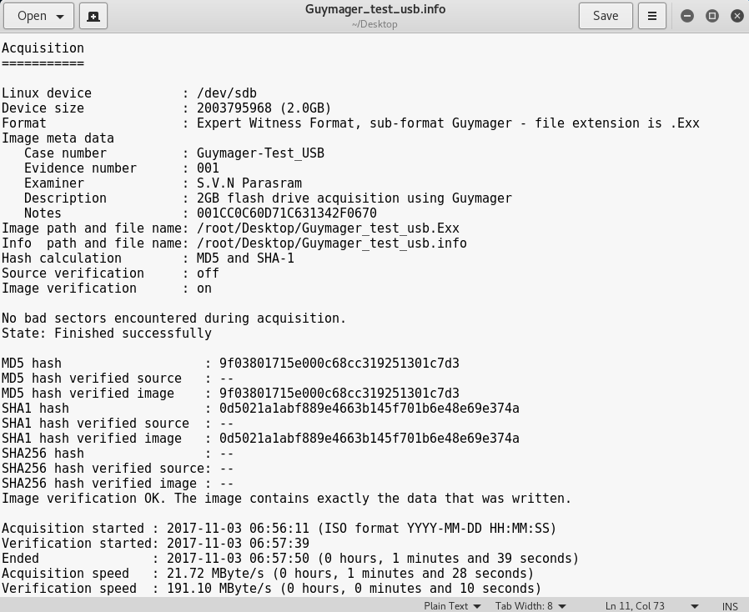

Slide 15
Let’s talk terms
Forensic image – A term used to describe a copy of data that is, both practically and legally identical. Also known as a bitstream or a bit-for-bit copy. How do we know it’s identical? With hashing…
Hashing – A term which, essentially, is a mathematical representation of data. We will speak more about this when we get to our later lessons, but for now the idea is that we use an algorithm to convert information to a new form. For example:
Hello world! = 86fb269d190d2c85f6e0468ceca42a20
hello world! = fc3ff98e8c6a0d3087d515c0473f8677
Hello world! = b1e3c772b8daac6cadf42a10ccb37346
Hello world! = 71f665ecf8883c275ed03b064dffbba7
Hello world! = ec65279864d3c60d6e7d2de59d975f5f (extra space on end)
THEREFORE – We take an image (or file/files) and our source data and generate the hash values. If target = source, the data is entirely identical.

Slide 16
Types of Disk Images
Physical: A bit for bit copy of the target drive or partition,.
Logical: A bit for bit copy of the files referenced in a file system.
Targeted File: A bit for bit copy of specific files from a file system.

Slide 17
Live vs. Dead Acquisition
Live: The capture of evidence from a powered-on system, and usually includes the acquisition of volatile evidence.
When a computer is encountered and it is powered off, the examiner can do “Dead Acquisition” – they can hook the drive up to a write blocker and take a forensic image – ensuring no changes are ever made to the drive and that the original data is perfectly preserved and never directly examined.

Slide 18
Live vs. Dead Acquisition
When a computer is powered on, there are endless changes being made, even if it is sitting idle. This includes places where data is only temporarily stored, and which are only accessible while the machine is powered on.
By running such a program and attaching a destination drive to the suspect computer, the examiner will make changes and/or additions to the state of the computer which were not present before his actions.
However, the evidence produced would still usually be considered admissible.

Slide 19
Live vs Dead
Live Acquisition:
Pro: Allows gathering of volatile evidence
Pro: Gets around disk encryption
Con: Makes changes to the system
Dead Acquisition:
Pro: Not all evidence is written to the disk until a proper shutdown occurs.
Pro: Less time pressure – the disk is not changing.
Con: Disk encryption might make future acquisition impossible

Slide 20
Order of Volatility
Digital evidence exists on a finite timeline, but that timeline depends upon what mode of evidence at hand. In this order, through the normal course of computer operations, the lifespan of evidence from shortest to longest is:
CPU, caches, registers, and RAM
Virtual memory
Routing table, ARP cache, process table, remotely logged data
Temp files
Data on disk
Backups and archival media
Printouts
It is important to triage your search accordingly. It may or may not be worth the effort and potential spoliation to do a live collection for the most volatile data. On the other hand, it might be critical.

Slide 21
Device Priority
Not only is evidence volatile, but it is also important to triage based upon device type. A powered off computer is less of a priority than a powered on cell phone.
Mobile devices have finite batteries – it could die and lock evidence behind encryption.
Mobile devices can be remotely wiped.
There might be anti-forensic tools that will become a problem if the device is powered off.
While rare, powered-on devices could have a “dead-man switch.”
General order of device collection:
Powered on mobile devices
Powered on computers
Powered on network devices
Other powered on devices (DVR, game console)
Powered off devices

Slide 22
“Common Sense” Rules of Evidence
Evidence is admissible only if it is relevant.
Relevant evidence is admissible unless and until another rule says it is inadmissible.
The judge presiding over a case can render your evidence admissible or inadmissible.

Slide 23
Qualities of Evidence
Evidence must be:
Admissible
If the evidence won’t stable up in court, it is useless.
Authentic
Evidence must be directly related to the incident at hand. Sometimes, through the course of an investigation, evidence may be rules irrelevant.
Complete
Evidence (and the process of investigation) should eliminate alternative theories and define an undeniable conclusion.
Reliable
There should be no question of the investigator’s conclusions, which means utilizing standardized tools and having credibility and reliability as an investigator.
Believable
The evidence should be clear and easy to understand.

Slide 24
Classes of Evidence
Real evidence: Something you could physically bring to court and show a jury. This is generally considered the most compelling. But is also the most rare in digital forensic circles.
Usually prima facie
Documentary evidence: Evidence in written form, which includes logs, email, etc.
Could be faked, and so must be authenticated prior to presentation.
Testimonial evidence: A statement of a witness under oath.
Not typically a part of the evidence an examiner would discover, but evidence an examiner might offer as an expert in the field.
Expert evidence is a special kind of testimonial evidence. It is required when matters in question reside outside the competence of the finder of fact.
Demonstrative evidence: Recreates or explains other evidence.
Sometimes a requirement to explain technical topics to laypeople like jurors or judges.

Slide 25
So What is Circumstantial Evidence?
Evidence that speaks to the root of the issue, without room for inference or interpretation is DIRECT EVIDENCE
Example: A video tape clearly showing the accused performing an illegal act.
CIRCUMSTANTIAL EVIDENCE is evidence that requires an inference to make a conclusion.
Example: A fingerprint at a crime scene. It only proves that the accused was present, and a viewer must interpret that information to conclude where, when, and why the accused was present.

Slide 26
So What is Circumstantial Evidence?
Digital forensic investigators generally provide circumstantial evidence.
Consider this scenario – An investigator determines that a user’s computer was used to access illegal material. The investigator could prove that:
The computer required a logon, meaning the user knew the username and password to the account.
When the logon occurred, establishing a timeline.
What network the computer connected to.
Whether the path to the illegal material was manually typed or accessed via a link/bookmark.

Slide 27
Federal Rules of Evidence Rule 401
Definition of "Relevant Evidence"
"Relevant evidence" means evidence having any tendency to make the existence of any fact that is of consequence to the determination of the action more probable or less probable than it would be without the evidence.

Slide 28
“Best Evidence”
The “Best Evidence” Rule
Evidence presented in court should be original and the actual item investigated or examined (and therefore considered “best evidence”).
Federal Rules of Evidence considers a printout of computer data to be “original” if it can be read by sight and if it accurately represents the stored data.
A proper forensic image can be considered best evidence if the original evidence has been returned to its owner

Slide 29
Federal Rules of Evidence Rule 1002
Requirement of Original
To prove the content of a writing, recording, or photograph, the original writing, recording, or photograph is required, except as otherwise provided in these rules or by Act of Congress.

Slide 30
Federal Rules of Evidence Rule 1003
Admissibility of Duplicates
A duplicate is admissible to the same extent as an original unless (1) a genuine question is raised as to the authenticity of the original or (2) in the circumstances it would be unfair to admit the duplicate in lieu of the original.

Slide 31
The Frye Standard
The Daubert case superseded, at the edict of the Supreme Court, the previous standard for expert evidence. The previous standard was from Frye v. US
Some jurisdictions still use the Frye standard, though. So here it is for your edification:
“Expert evidence is admissible if it’s collection and analysis was based upon techniques generally accepted as reliable in the relevant scientific community.”

Slide 32
The Daubert Test
The case of Daubert v. Merrill Dow Pharmaceuticals established new criteria to determine the reliability, relevancy, and admissibility of scientific evidence.
The theory or technique must have been tested, and that test must be replicable.
The theory or technique must have been subject to peer review and publication.
The error rate associated with the technique must be known.
The theory or technique must have standards and protocols for the execution of the scientific procedure.
The theory or technique must enjoy general acceptance within the scientific community
This established an objective set of guidelines for accepting scientific evidence.

Slide 33
The Kumho Tire Extension
The case of Kumho Tire v. Carmichael extended the Daubert standard to the qualification of expert witnesses.
Daubert enforced a standard for experts who supply evidence in the sphere of “scientific, technical, or other specialized knowledge.” It made no distinction between the three.
In Kumho Tire v. Carmicheal, the Court determined that the line between scientific and technical is not so clear, and determined that the Daubert test would apply to ALL expert testimony.

Slide 34
Federal Rules of Evidence Rule 702
Testimony by Experts
If scientific, technical, or other specialized knowledge will assist the trier of fact to understand the evidence or to determine a fact in issue, a witness qualified as an expert by knowledge, skill, experience, training, or education, may testify thereto in the form of an opinion or otherwise, if (1) the testimony is based upon sufficient facts or data, (2) the testimony is the product of reliable principles and methods, and (3) the witness has applied the principles and methods reliably to the facts of the case.

Slide 35
Federal Rules of Evidence Rule 703
Basis of Expert Testimony
An expert may base an opinion on facts or data in the case that the expert has been made aware of or personally observed. If experts in the particular field would reasonably rely on those kinds of facts or data in forming an opinion on the subject, they need not be admissible for the opinion to be admitted.

Slide 36
Federal Rules of Evidence Rule 705
Disclosure of Fact in Expert Opinion
Unless the court orders otherwise, an expert may state an opinion—and give the reasons for it—without first testifying to the underlying facts or data. But the expert may be required to disclose those facts or data on cross-examination.

Slide 37
But what about Hearsay?
Hearsay is the report of another person's words by a witness.
“Joey said he was going to kill her.”
“I noticed she forgot her phone. I heard it buzz and the screen came on and I saw a text that said, ‘I’ll brb, I’m off to rob the liquor store lol’”
The main argument in digital forensics against hearsay is the business record exception (Federal Rules of Evidence 803(6)

Slide 38
Federal Rules of Evidence Rule 803(6)
(6) Records of regularly conducted activity.
A memorandum, report, record, or data compilation, in any form, of acts, events, conditions, opinions, or diagnoses, made at or near the time by, or from information transmitted by, a person with knowledge, if kept in the course of a regularly conducted business activity, and if it was the regular practice of that business activity to make the memorandum, report, record or data compilation.

